Slide 1
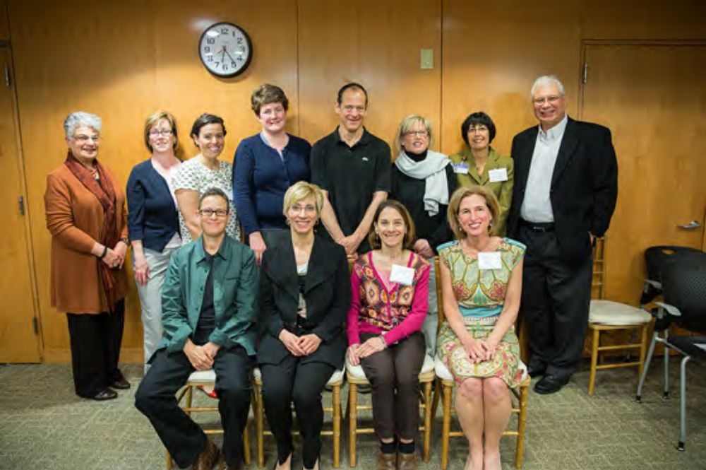
Can Patient/Family Advisor Rounding
Improve Patient Experience and Safety?
Barbara Sarnoff Lee, LICSW,
Sr. Director of Social Work and Pt./Family Engagement
Caroline Moore, MPH,
Program Leader,
Pt./Family Engagement
Nicola Truppin,
Patient/Family Advisor
Advisor Rounder

Slide 2
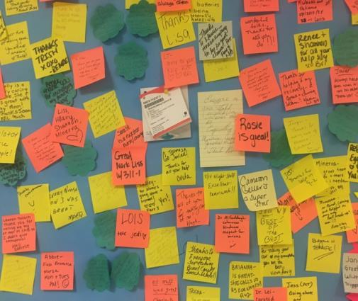
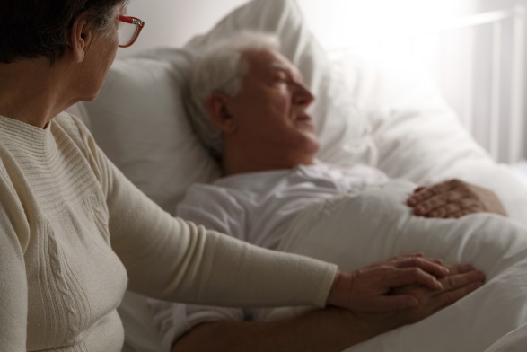
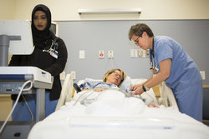
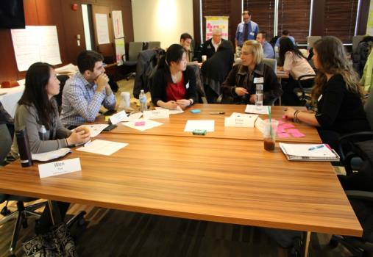
Patient/Family Advisor Rounding: Why?
Pay for performance around patient experience measures
To discern systems- and individual-level conditions in real time, in the patient voice, allowing us to identify the right tool for the job
To generate continuous and growing body of qualitative data for ongoing improvement
To offer patients confidential, personalized, and immediate way to share concerns and feedback

Slide 3
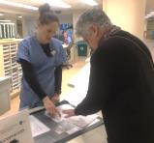
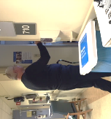

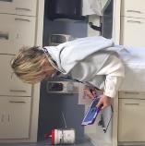
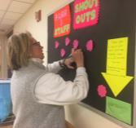
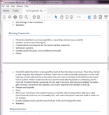
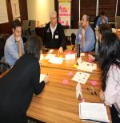
Process
Nurse reviews patients with patient/ family advisor
Advisor rounds on patients
Immediate needs are addressed
Comments documented on web-based form
Employees receive positive feedback
Unit and department leaders, QI teams receive reports
Data used for systems improvement and teaching
Notes:
Many comments are positive, but sometimes we discover things that have gone wrong.
We might never have known about some of these issues had we not rounded.

Slide 4
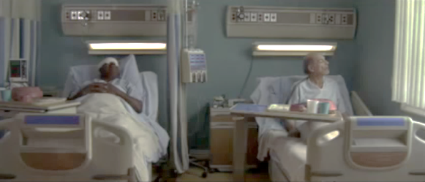
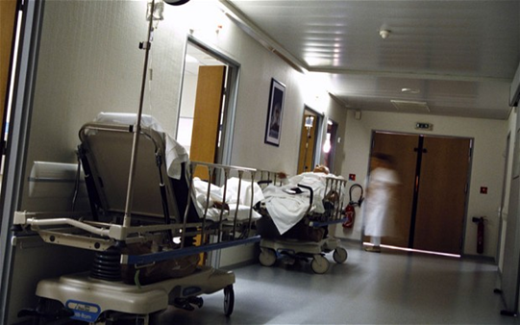
Respect and Dignity
“Monday, patient in bed 1 needed to get to the bathroom. He said when he called for help ‘the woman at the front desk gave me a bad attitude’ and ignored his calls; he had an accident in his bed. He said: ‘I felt humiliated and like I was being treated like a nobody.’”
“Patient troubled that he is sometimes left alone in a corridor having no idea where he is or why he is there. He said: ‘Nobody tells me, ‘Hey, Mr. B., we are taking you to get x, y or z test’. Why is it not explained to me? I am completely ignored, bumped into, and all alone.’”

Slide 5
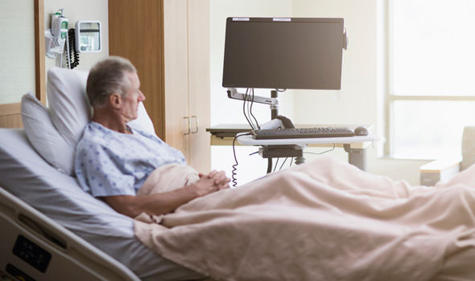
Communication
“Patient met the doctor before his stent surgery but that is when communication stopped. He is getting discharged today but nobody told him a time. He has no idea of his plan of care. Can he ski? Is he supposed to take it easy?

Slide 6

Responsiveness
“I spoke with wife of patient; husband was having heart surgery. Yesterday she asked three different people if they could send a minister to pray with her. A Catholic priest finally came in the evening, but by then the room was filled with family and visitors and she felt uncomfortable. She was told that if she wanted to pray, she could go downstairs to the chapel, but when she got there after the visitors left, it was locked.”

Slide 7
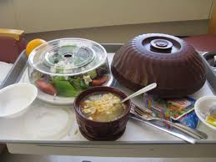
“She couldn’t get what she wanted for breakfast; dietary has her incorrectly listed as lactose intolerant. Patient insisted that is not the case. A nurse said she would try to resolve it but patient never got follow-up. Patient did not get breakfast or lunch.
For dinner she ordered soup. It contained legumes, which she cannot have because of gout. They sent rice pilaf up as a substitute, but it contained peas. When she called again, she was told ‘push the peas out of the way’. Patient did not have dinner.”
Food Services

Slide 8
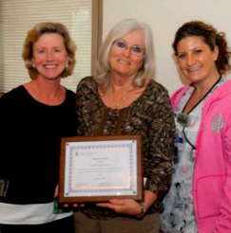
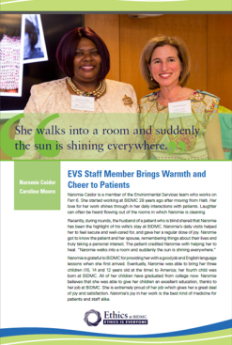
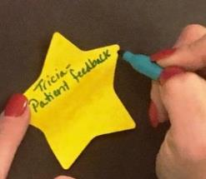

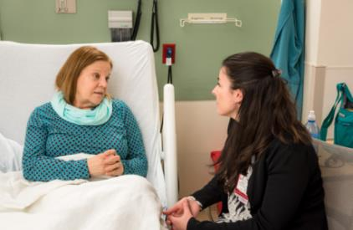
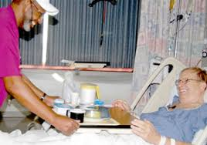

Positive Outcomes
For patients:
  Patient-to-patient support
  Alleviation of emotional harm
  Assistance with conditions impacting comfort, safety and healing
  For BI:
  Immediate feedback allows for timely response
  Recognition of exemplary staff
  Granular data has informed systems improvements and teaching

Slide 9
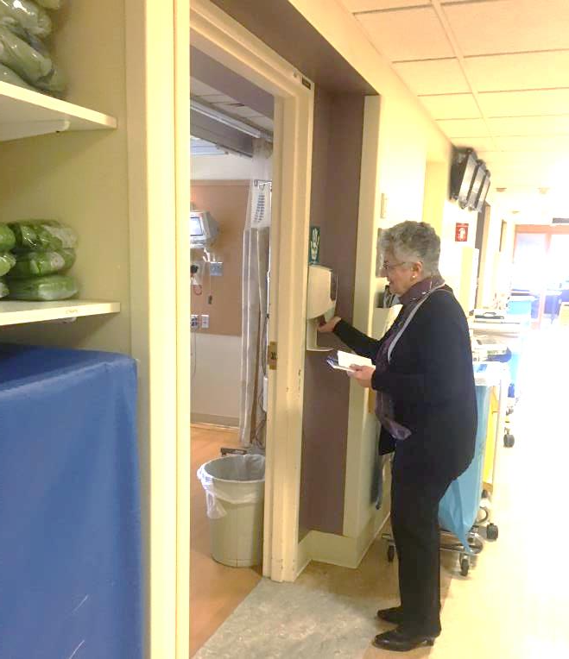
Stories

Slide 10

Rounder: “What is one thing we could do to improve your experience here?”
Patient: “Make people understand, we are giving up control and handing our lives over to you.”
Contact Information:
Barbara Sarnoff Lee: bsarnoff@BIDMC.harvard.edu
Caroline Moore: cpmoore@BIDMC.harvard.edu
Nicola Truppin: ntruppin@BIDMC.harvard.edu

